Slide 1
Welcome

Slide 2
Note for the honourable teachers:
The subject teachers are requested to read the notes given below the slides.
Notes are given bellow the slide no. 7, 8, 9, 11, 14, and 15.

Slide 3
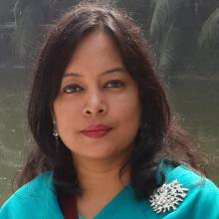
INTRODUCTION
ROUFUN NAHAR
ASSISTANT TEACHER ( ENGLISH)
MAZIDA GOVT. HIGH SCHOOL
TONGI, GAZIPUR
CLASS: SEVEN
SUBJECT: ENGLISH FIRST PAPER

Slide 4
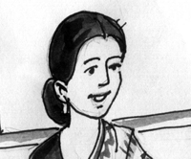
Can you guess what her profession is?
She is a teacher.
Doctor
Nurse
Engineer
Can you tell what she does in school and at her home?
Teacher
Business
Fashion
designer
Discuss with your friend what she does in the school and at her house.

Slide 5
Today our topic
A Teacher(2)
UNIT: Four
LESSON: 2

Slide 6
LEARNING OUTCOMES OF THE LESSON
By the end of the lesson the students will be able to
Ask and answer questions.
Read and understand text.
Talk about people.
Fill in the gaps.
Tell the meaning of some key words from inference.

Slide 7
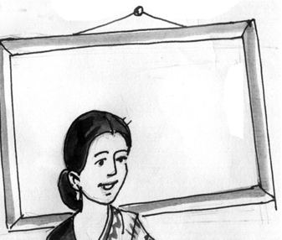
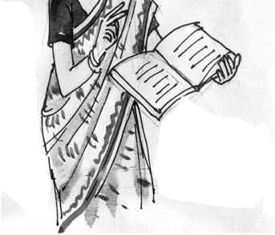
Ask your friend the following question.
What is she doing?
She is teaching.
Notes:
The students can ask the question to their partners. It will be pair work. (Ask and answer question for developing speaking skill)

Slide 8
Ask your friend the following question.
What is she doing?
She is talking to the students.
Notes:
The students can ask the question to their partners. It will be pair work. (Ask and answer question for developing speaking skill)

Slide 9
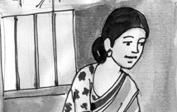
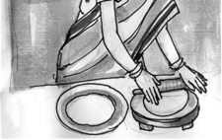
Ask your friend the following question.
What is she doing?
She is doing her household work/She is making bread.
Notes:
The students can ask the question to their partners. It will be pair work. (Ask and answer question for developing speaking skill)

Slide 10
Ask your friend the following question
What are people doing to her?
People are giving her salaam.
Notes:
The students can ask the question to their partners. It will be pair work. (Ask and answer question for developing speaking skill)

Slide 11
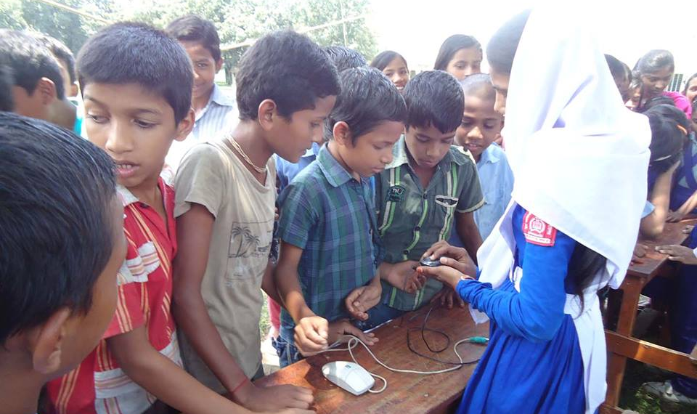
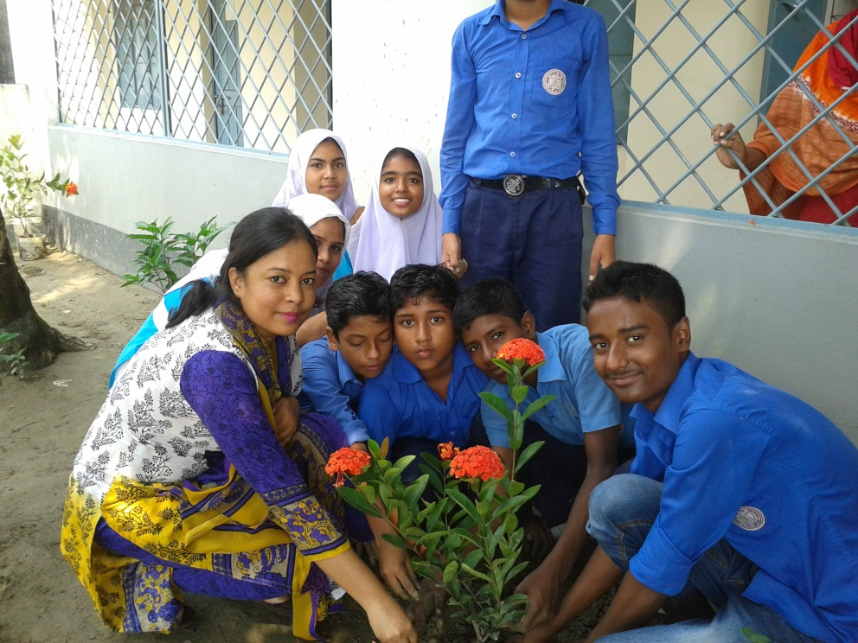
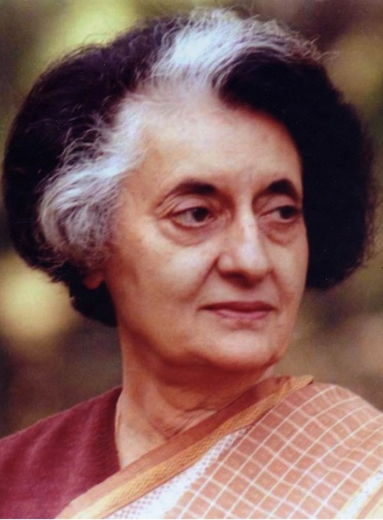
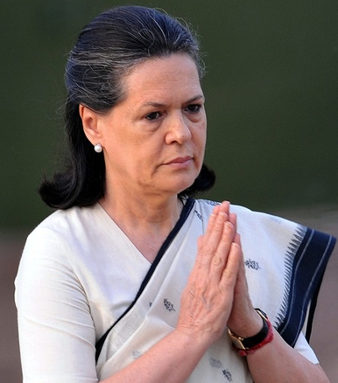
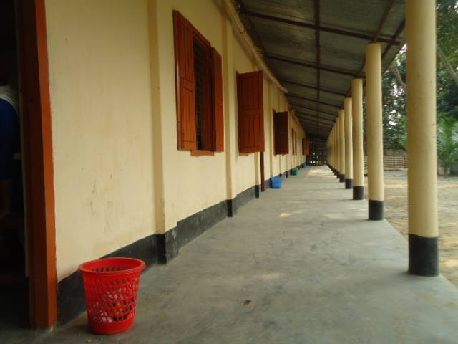
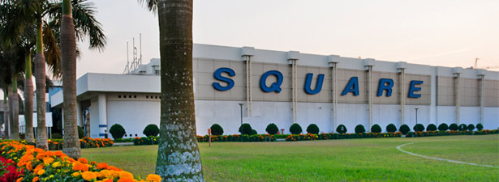
Vacant
Vocabulary
Company
Corridor
Demonstrate
Inspire
In-laws
fill (someone) with the ability to do or feel something good; encourage
a long passage in a building from which doors lead into rooms
having no fixtures, furniture, or inhabitants; empty
show (something) clearly by giving evidence.
relatives by marriage.
Meaning
a commercial business.
Meaning
Meaning
Meaning
Meaning
Meaning
There is nothing in the box. It is vacant.
The Square is a renowned pharmaceutical company in Bangladesh.
The classes are going on. There is nobody in the corridor.
The teacher is helping students to make garden. Thus she inspires students to do good work.
The girl is demonstrating how a mouse works.
Indira Gandhi is mother- in-law of Sonia Gandhi .
Notes:
First, the word will be shown. The SS will be asked to pronounce the word. If it is needed teacher can help. Then the picture and the sentence will be shown and asked to guess the meaning. After that the meaning will be shown. Then the teacher can ask the students to make a sentence of their own. In the same way, slide no. 7-11 can be conducted.

Slide 12
Individual/Pair Work
Go to the section B in the text book then match the words with their meanings.

Slide 13
Individual Work
Read the text from the textbook , section A and make a list of things that Shahana does as a teacher.

Slide 14
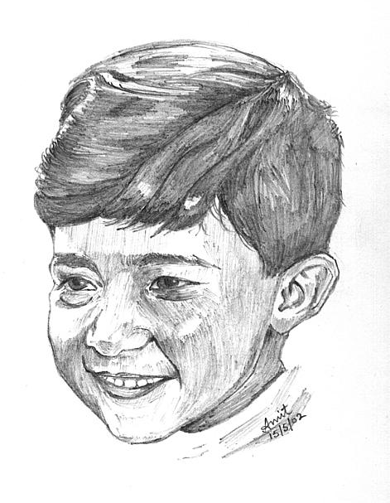
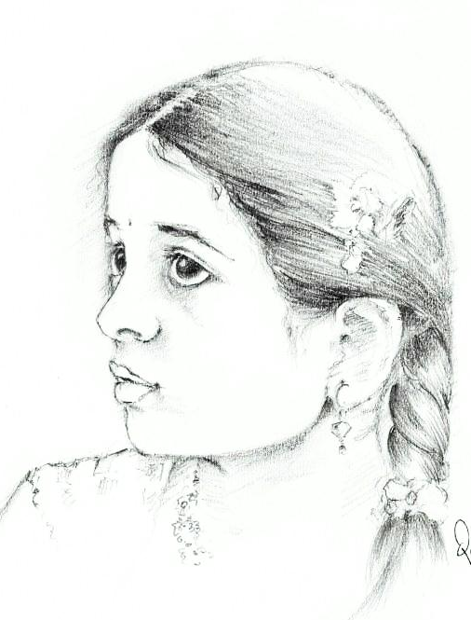
Help them to complete the dialogue filling the gaps. Take the words from the box.
do
want
What do you …….. to be?
Why …….. you want to be a Lawyer?
Because I ………. it. . I want to ……… the people get ……….. .
like
Lawyer
help
I want to be a ……….
.
justice
do
want
like
Lawyer
help
justice
Notes:
This is the gap fill activity.

Slide 15
Pair Work
Now in the same way you ask and answer with your friend about what you want to be.
1. What do you want to be?
2. Why do you want to be a ………..?
Notes:
The students can ask and answer questions in pairs. Then the teacher can ask few pairs to come in front and act out.

Slide 16
Individual/Pair Work
Read the passage from section E and complete the passage with words from the box. A word can be used more than one time.

Slide 17
Home Work
Recently you have meet your cousin Shamin/Shamima. Now write a dialogue between you your cousin about what you want to be.

Slide 18
I want to be a Fashion designer.
I want to be a Lawyer.
Fix it. It will help you to become a successful person.
What about all of you?
Thank you all

Slide 19
Acknowledgement
MoE, DSHE, NCTB & A2I respective of officials
And the editors panel: Ranjit Poddar, Associate Professor (English) TTC, Dhaka, Md. Jahangir Hasan (English), Assistant Professor TTC, Rangpur and Urmila Khaled Assistant Professor (English) TTC, Dhaka.
Their direction, valuable suggestions and intensive supervision have enriched the model contents.

